Slide 1

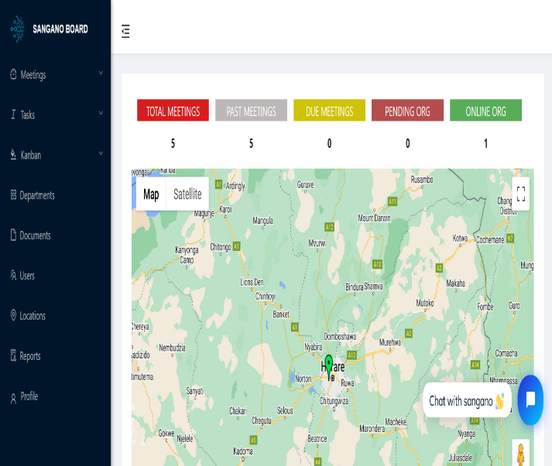
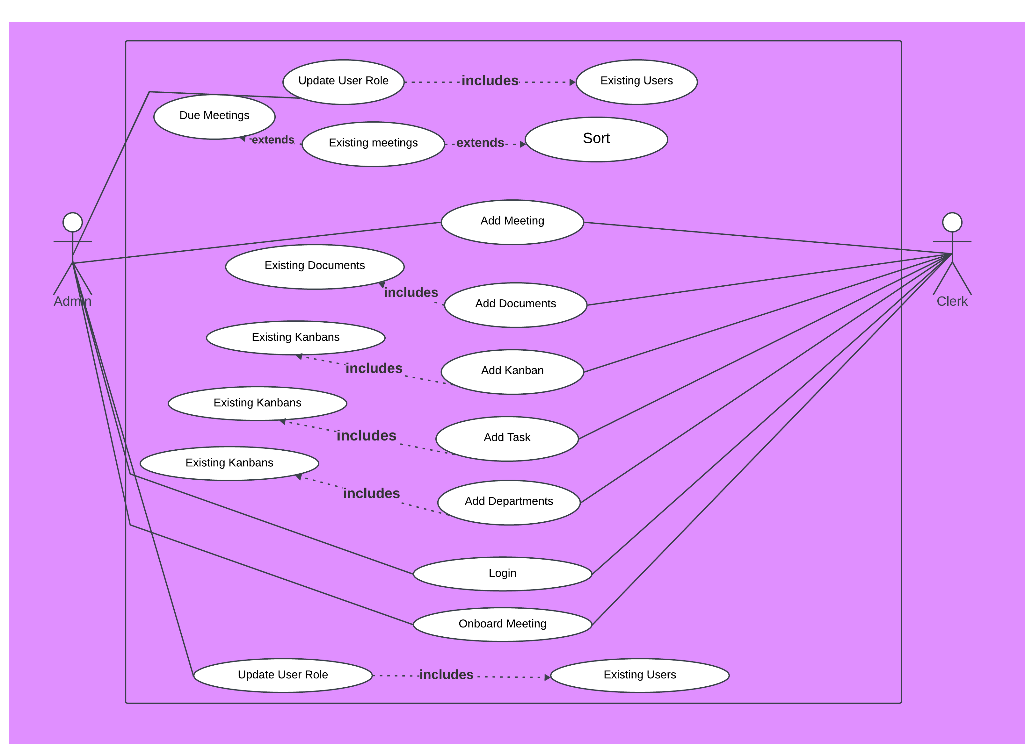
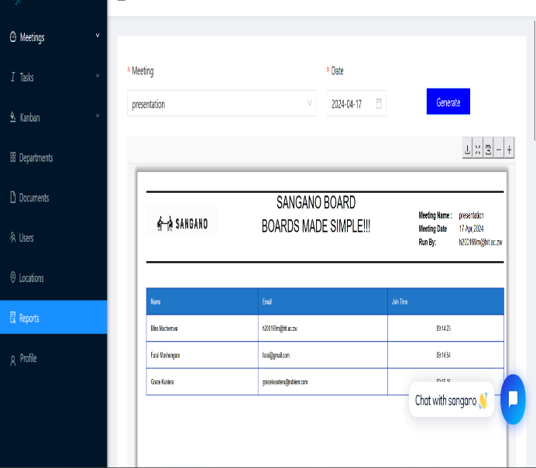
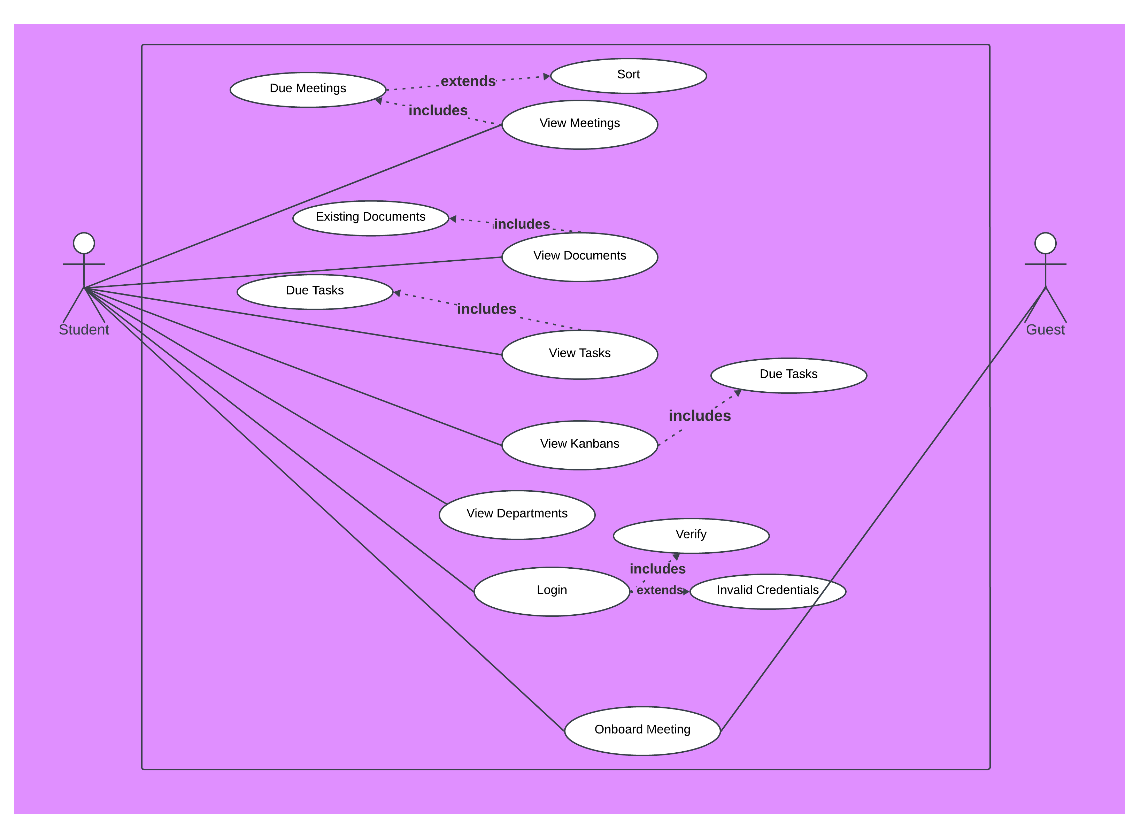
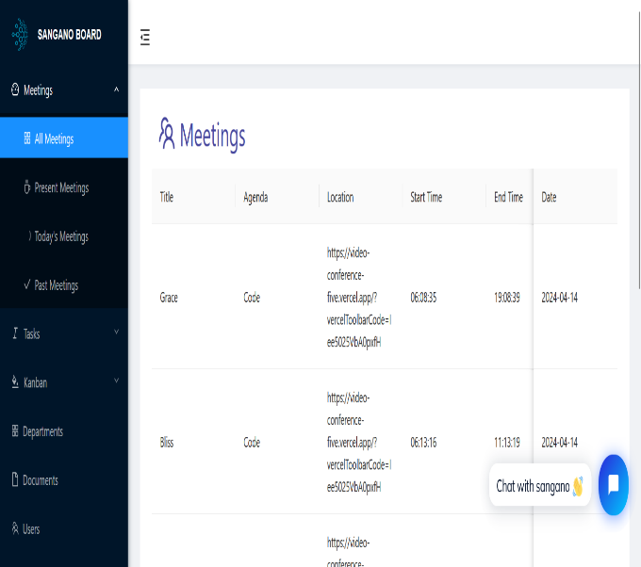
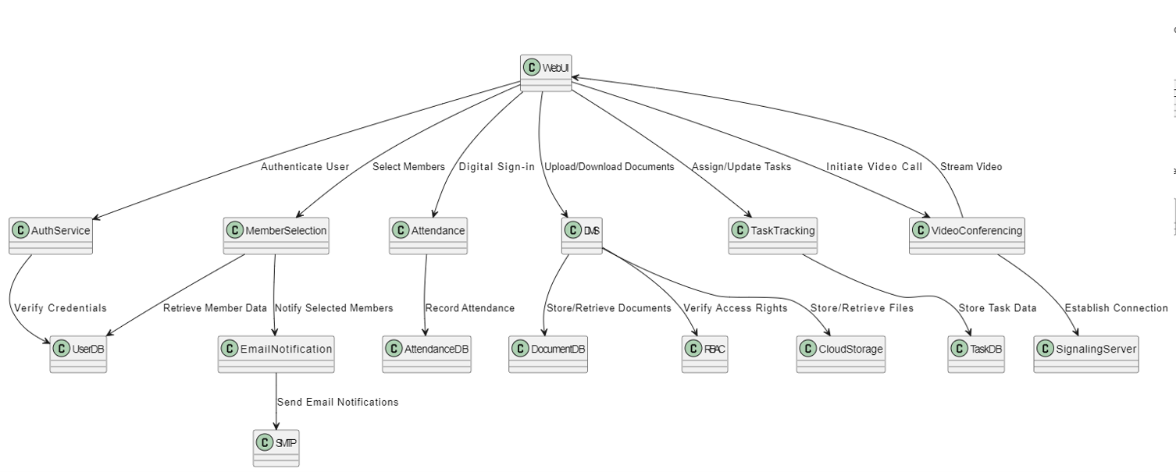
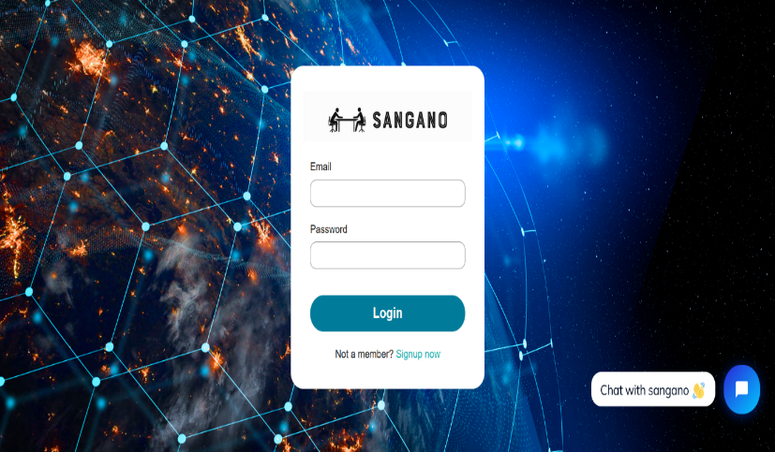
SANGANO BOARD
Tatenda Bliss Muchemwa - Software Engineering Department
1.0 Abstract
4.0. Overview of the developed application
7.0. Use Case Diagram
Traditional board meetings often struggle with inefficiency and limited collaboration. In response, we present the Sangano Board, an innovative digital platform reshaping the landscape of organizational meetings. With a suite of advanced tools facilitating smoother planning, effortless communication, and seamless document handling, this application significantly improves decision-making processes and enhances overall accountability. Through the integration of cutting-edge technology and intuitive design principles, the Sangano Board represents a promising advancement in board meeting effectiveness, promising to set new standards for organizational governance.
The Sangano Board Meeting Application is designed to revolutionize board meetings by implementing a custom filtering algorithm for member selection based on department and automating email notifications. It features a real-time video conferencing system using WebRTC technology, ensuring seamless remote participation. The application includes attendance recording and report generation capabilities, facilitating accurate tracking and documentation. A comprehensive document management system with Role-Based Access Control (RBAC) enhances security and organization of meeting materials. Additionally, a robust task tracking system, powered by the Task Track Algorithm, ensures efficient follow-up and accountability on action items. Together, these features create an integrated, efficient, and secure platform for modern board governance.
2.0. Introduction
Traditional board meetings often struggle to achieve efficiency and transparency, creating challenges for organizational governance. Recognizing these obstacles, the Sangano Board emerges as a beacon of innovation, aiming to revolutionize how board meetings are conducted. Through a blend of cutting-edge technology and a keen focus on user needs, the Sangano Board addresses the shortcomings of conventional meeting practices with precision. By delving into the intricacies of traditional board meetings, Sangano Board crafts a solution that streamlines the planning process, maximizing the utilization of time and resources. Additionally, it empowers board members with real-time decision-making support, equipping them to navigate complex discussions with clarity and confidence. Moreover, the platform's robust document management system ensures easy access to essential resources, fostering a culture of accountability and informed governance. In essence, the Sangano Board heralds a new era of boardroom efficiency and collaboration, promising to reshape organizational governance practices for the better.
5.0. Objectives
To implement a Custom Filtering Algorithm for member selection based on department and automate email notifications.
To develop a real-time video conference system using WebRTC technology.
To implement attendance recording and report generation features.
To develop a comprehensive document management with RBAC.
To design and develop a robust task tracking using Task Track Algorithm.
3.0. Problem definition
6.0. System Overview
Conclusion
Traditional methods of conducting board meetings face significant inefficiencies and exclusionary practices due to outdated approaches and fragmented communication channels. Manual scheduling procedures and ineffective document management systems often lead to confusion, disjointed discussions, and increased risks of data breaches. Additionally, with the rise of remote work, these challenges are further compounded, making it difficult to coordinate meetings and ensure fair participation. Board members often lack access to real-time data, resulting in delays and uninformed decision-making. The absence of integrated communication tools can lead to siloed discussions, where critical information fails to reach all stakeholders in a timely manner. Moreover, the logistical complexities of organizing meetings across different time zones and locations further strain resources and reduce overall efficiency. To tackle these issues, there is a need for digital solutions that can streamline meeting processes, enhance communication effectiveness, and promote inclusivity in decision-making.
The Sangano Board application represents a significant advancement in transforming board meeting dynamics within organizations. By streamlining processes, enhancing collaboration, and fostering accountability, Sangano Board sets a new standard for efficient and effective governance. With continuous improvements in user experience, integration with essential tools, advanced analytics, and mobile accessibility, the future holds even greater potential for revolutionizing organizational decision-making. Sangano Board stands poised to lead the way towards a future where board meetings are not just events but catalysts for meaningful progress and innovation.
8.0. Screenshots
Supervisor – K. Chiworera

